Slide 1
Intro to Machine Learning
Jose Nuñez Dec 2019

Slide 2
Contents
01 |  | What is machine learning?
02 |  | Why to use machine learning?
03 |  | Types of ML
04 |  | Supervised, Unsupervised, Reinforcement learning
05 |  | Instance base vs model base learning
06 |  | Overfitting / Underfitting
07 |  | Testing and Validating

Slide 3
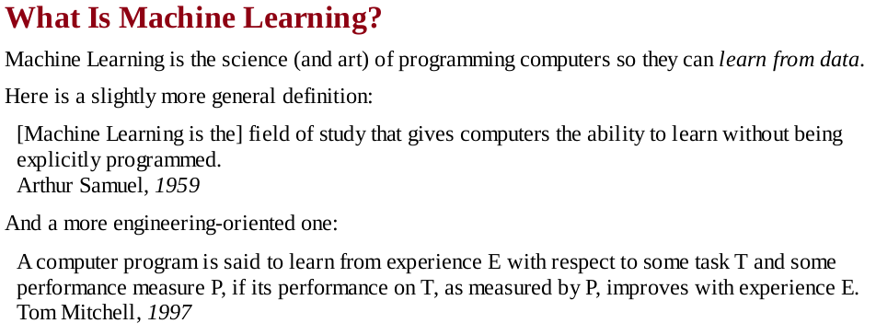
Machine Learning Concept

Slide 4
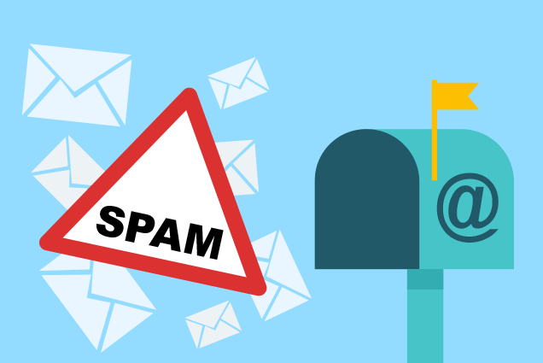
Why to use Machine Learning? Spam emails example
Imagine you are hired by NotGmail corp as a programmer and your mission is to create a way of filtering spam emails.
How would you tackle this problem Without ML?

Slide 5
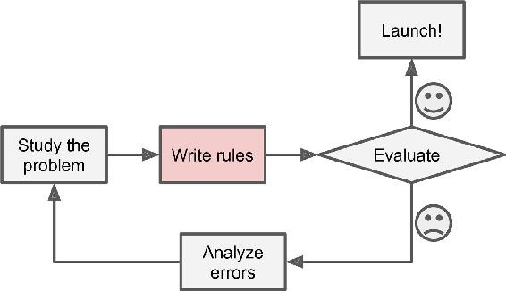
Why to use Machine Learning? Spam emails example: The classical approach

Slide 6
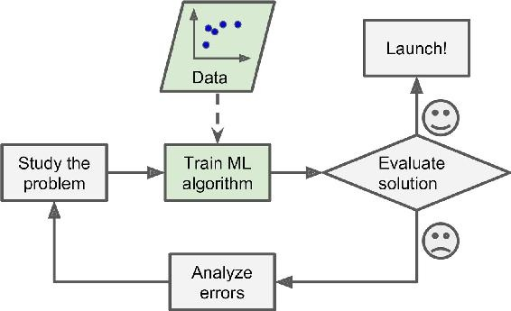
Why to use Machine Learning? Spam emails example: The Machine Learning approach

Slide 7
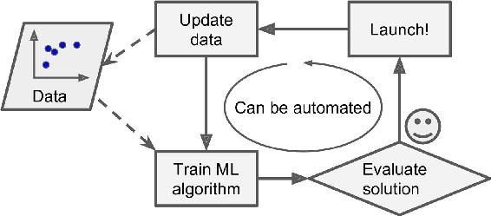
Why to use Machine Learning? Spam emails example: Advantages

Slide 8
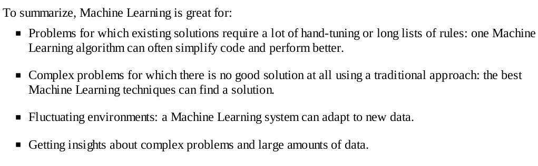
Why to use Machine Learning?
Give 1 example where to use ML

Slide 9
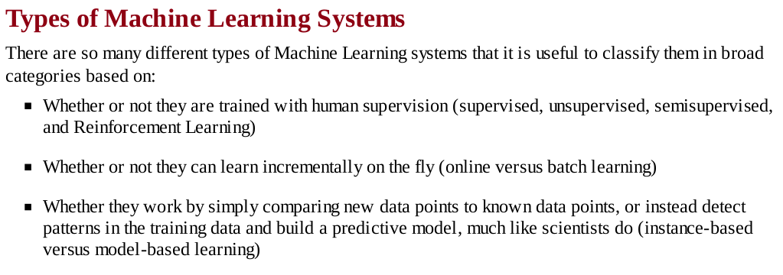
Machine Learning Basics

Slide 10
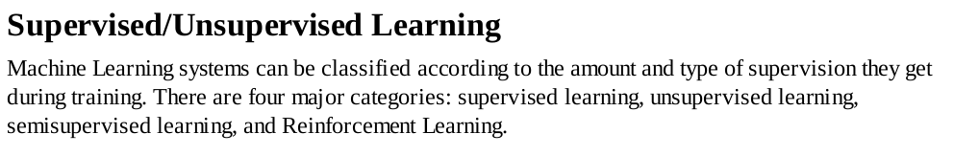
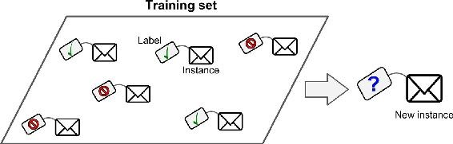
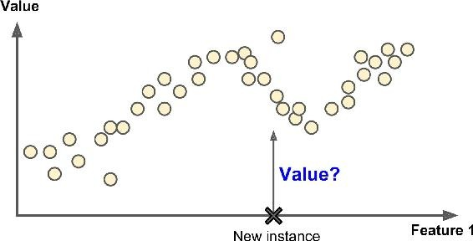
Does Human supervise the process?
Supervised learning
In supervised learning, the training data you feed to the algorithm includes the desired solutions, called
labels

Slide 11
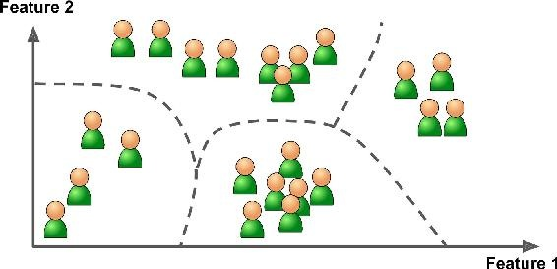
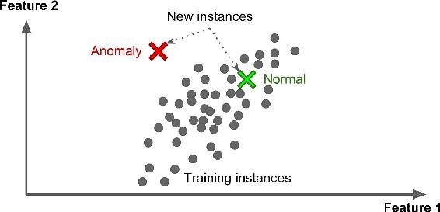
Does Human supervise the process?
Unsupervised learning
In unsupervised learning, as you might guess, the training data is unlabeled. The system tries to learn without a teacher.

Slide 12
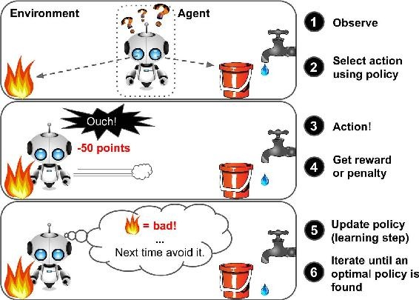
Does Human supervise the process?
Reinforcement Learning
Reinforcement Learning is a very different beast. The learning system, called an agent in this context,
can observe the environment, select and perform actions, and get rewards in return.
It must then learn by itself what is the best strategy, called a policy, to get the most reward over time.
A policy defines what action the agent should choose when it is in a given situation.

Slide 13
Overfitting

Slide 14
Testing and Validating

Slide 15
Quiz!

Slide 16
Thank you!

